Slide 1
Guns, Explosives and Weapons Control Act 2021 (GEWCA) Online Briefing for E-Commerce Platforms
Police Regulatory Department
28 January 2026
Official (Open) / Non-Sensitive

Slide 2
Objectives
Raise awareness of Guns, Explosives and Weapons Control Act (GEWCA) provisions that affect e-Commerce Platforms
Clarify responsibilities of e-commerce platforms and compliance expectations
Highlight key risk areas and common non-compliance

Slide 3
Scope
Background to Regulatory Changes
Overview of GEWCA
GEWCA Regulatory Regime for Guns
GEWCA Regulatory Regime for Explosives
GEWCA Regulatory Regime for Explosive Precursors (EP)
GEWCA Regulatory Regime for Weapons/ Noxious Substances
Case Studies and Penalties
Non-Regulated Items
Resources
FAQ

Slide 4
Background to Regulatory Changes

Slide 5
Background to Regulatory Changes
E-Commerce platforms enable the sales of a wide range of goods, including high-risk items. Online listings and digital transactions can facilitate access to controlled items
Singapore law recognises that online facilitation and physical supply are both part of the risk chain
Real world examples:
Overseas cases have shown online platforms being used to market weapon parts and explosive-related items
Illicit sellers have leveraged e-commerce and social platforms to reach consumers and evade controls
E-commerce platforms and marketplace operators need to be aware of the operationalisation of GEWCA, which came into force on 1 July 2025, and its implications for online facilitation and listings.
Notes:
\

Slide 6
Overview of Guns, Explosives and Weapons Control Act 2021 (GEWCA)

Slide 7
Overview of GEWCA
The Guns Explosives and Weapons Control Act (GEWCA) came into effect on 1 July 2025.
Replaced and consolidated the following legislations:-
Arms and Explosives Act (AEA)
Dangerous Fireworks Act (DFA)
Explosives Substance Act (ESA)
Strengthens regulation over guns, explosives, explosives precursors, noxious gases and substances and certain weapons.

Slide 8
Overview of GEWCA Regulatory Regime
Key changes in GEWCA
Enhanced punishments and penalties
Aligns requirement across physical and online marketplaces
Inclusion of desensitized explosives previously regulated under other regimes
Introduction of new licence types (e.g. bundle licences)
Single application for related activities
Cost and time savings for licensees
Longer licence tenure (up to 3 years)
Introduction of a Class Licensing framework for low-risk users and items

Slide 9
Overview of GEWCA
All online sales of guns, explosives, explosive precursors, weapons and noxious substances are regulated under GEWCA and they include:
Platforms which are set up by physical retailers that handle the entire supply process
e.g retailers with online shops
Platforms which are not retailers but play a role in the supply process, such as storing or repackaging the items, and/or delivering the items
e.g companies which provide a platform for retailers to advertise the sales and also handles the goods on behalf
Platforms which allow listings and act as middlemen but do not physically handle the items
e.g. facilitate negotiations between the sellers and buyers (e.g companies which provide a platform for retailers to advertise the sales)

Slide 10
Overview of GEWCA
Align the regulatory requirements of physical shop dealers and e-commerce platforms.
Prohibit online sale of guns, noxious substances, explosives and explosive precursors.
Permit the sale of the following type of weapons online, if the sellers meet the requisite licensing conditions or are exempted under the law:
- Types 1, 2 and 3 weapons according to the risks posed to safety and security.

Slide 11
Regulated Items under GEWCA
Guns | Explosives | Explosive Precursors (EP) | Noxious Substances | Weapons
Firearms (e.g. pistol, shotgun, rifle, etc.) Non-Firearms (e.g. Air-guns, paintball guns) Guns (e.g. Tranquiliser gun, Stun gun, Spear gun) Gun accessory Digital files/blueprints for gun parts | Ammunition Explosive substances Fireworks Flares Desensitised explosives (DE) Certain lower risks – Class Licence (e.g. Airbags) Certain Lower risks – Exempted from Licence (e.g. Christmas crackers) | Dual-use chemicals with potential misuse (e.g. can be used for industrial purpose or improvised as explosives Such as ammonium nitrate, hydrogen peroxide, etc.) | Nauseating or lachrymatory substance (e.g. pepper spray) | Categorised by design, use and licensing requirements: Type 1 (Licence)– Designed to cause hurt and have very limited legitimate day-to-day uses (e.g. karambit knives) Type 2 (Class Licence) – Designed to cause hurt but have specified legitimate uses such as sporting, theatrical, ornamental purposes (e.g. sword) Type 3 (No Licence)– Designed as tools of trade but may be misused to cause hurt (e.g. axes)

Slide 12
Regulated Activities under GEWCA
Licence | Guns | Explosives | EPs | Noxious Substances | Weapons
Manufacture | ü | ü | ü | ü | ü
Supply | ü | ü | ü | ü | ü
Possess | ü | ü | ü | ü | ü
Store | ü | ü | ü | - | -
Repair | ü | ü | - | - | ü
Dispose | ü | ü | ü | ü | ü
Range | ü | - | - | - | -
Import/Export | ü | ü | ü | ü | ü
Conveyance | ü | ü | ü | ü | ü
Rock Blasting | - | ü | - | - | -
Fireworks Display | - | ü | - | - | -
Activity already existed under previous AEA and regulations
New Licences introduced under GEWCA
(-) Not applicable

Slide 13
GEWCA Regulatory Regime For Guns

Slide 14
Definition of “Gun” under GEWCA
Under Section 3.(1) “gun” means an object or a thing that, if used in the way for which it is or was designed or adapted, is or was capable of being aimed at a target and causing hurt or injury by —
(a) propelling a bullet, shot or other projectile (which may or may not contain any noxious substance); or
(b) discharging any corrosive substance or poison, by means of a burning propellant, compressed air or other compressed gas, or an explosive force (however caused), and includes any of the following:
(c) an object or a thing mentioned in subsection (2)(a);
(d) a collection of major parts of a gun mentioned in subsection (2)(b).
======================================================================================
Subsection
(2)(a) an object or a thing that would be a gun — (i) if it did not have something missing from it, or a defect or obstruction in it; or (ii) if it were not for the fact that something has been added to it, must be taken to be a gun;
(b) a collection of the major parts of a gun that if assembled would be a gun (or would be a gun if it were assembled and in working order) is taken to be a gun; and
(c) a reference to a gun of a particular category or kind includes a reference to an object or a thing that would be a GUNS, EXPLOSIVES AND WEAPONS CONTROL 19 gun of that category or kind if not for paragraph (a)(i) or (ii).

Slide 15
Definition of “Gun” under GEWCA
Examples
An electronic dart gun.
A ballistic knife.
A handgun or revolver.
An automatic gun or pistol.
A spear gun.
A stun gun or taser.
A firearm designed to fire projectiles containing tear gas or poison.
A firearm designed to tranquillise, immobilise or administer vaccines or other medicines to animals.
A howitzer, mortar, bazooka and similar military firearms designed to fire explosive projectiles.
A machine gun or sub-machine gun.
A self-loading rifle or shotgun.
A paint-pellet gun or paintball marker.
An airgun.
A starting pistol the purpose of which is for use in the starting of racing events in sporting competitions.

Slide 16
Definition of “major part of a gun” under GEWCA
“major part of a gun” means any component —
(a) that, of itself, is essential to the discharge of any shot, bullet, missile, or other projectile from the gun;
that is exclusively designed to be, or is intended to be, an integral part of the gun, without which the gun would be considered inoperable or incomplete; or
that feeds or contributes to feeding ammunition to the gun.
Examples
A gas piston, friction ring, action bar, breech bolt or breech block.
A firearm barrel.
A trigger or firing mechanism.
A frame or receiver.
A slide.
An upper or a lower receiver.
A revolving cylinder.
A bolt carrier.
An adjustable, detachable or folding stock.
Notes:
GEWCA also defines major parts such as barrel, frame, receiver and cylinder. Even if these are 3-D printed, they still fall under regulation if they serve the same function.

Slide 17
Definition of “gun accessory” under GEWCA
“gun accessory” means any object or thing that —
(a) is not a major part of a gun;
(b) is not a weapon;
(c) is designed to be fitted to, or adapted to fit, a gun; and
(d) whether or not complete, damaged, temporarily or permanently inoperable, or unfinished, can be fitted to, or adapted to fit, is —
(i) a magazine adapter;
(ii) a flash suppressor;
(iii) a silencer, sound moderator, sound suppressor or any other device designed to reduce, or capable of reducing, the noise of discharge of the gun;
(iv) a mechanism or other device designed to modify, or capable of converting, a gun to give it any of the following capabilities:
(A) burst fire;
(B) semi-automatic operation;
(C) fully automatic operation; or
(v) any other mechanism or device that is prescribed (by description, model or otherwise) for the purposes of this definition;

Slide 18
Subsidiary Legislation Relevant to Guns under GEWCA
Under S122 of Guns, Explosives and Weapons Control (Guns) Regulations 2025
Specifies licensing requirements for guns and major gun parts
Controls manufacture, repair, import, export, dealing, possession

Slide 19
GEWCA Regulatory Regime for Guns
Under GEWCA, it is an offence, if
the person possesses a digital blueprint for the manufacture of a gun or a major part of a gun on a 3D printer or on an electronic milling machine; and
the person is not one of the following:
(i) a person granted a licence to manufacture the gun or major part of a gun using
a 3D printer or on an electronic milling machine;
(ii) a person exempt from this section under section 87, 88 or 89 in relation to that manufacture of the gun or major part of a gun.
Section 87 - General exemption for law enforcement, etc
Section 88 - Exemption for defence purposes
Section 89 - Administrative exemption

Slide 20
What Constitutes an Offence
3D Printing or producing any part of a gun
Possessing or sharing digital blueprints that can make such parts
Supplying or conveying firearms components
Conducting 3D printing, training or file-sharing involving gun/ gun parts or blueprints without a valid licence or authorization
Applies whether done intentionally or recklessly

Slide 21
Realistic Toy / Replica Guns (Regulated under RIER)
Police do not allow the import of toy guns that:
Closely resemble real firearms
Can be modified to look realistic
Shoot hard projectiles
Are “Cap Guns”
Exceed prescribed projectile speed limits (e.g. above 250 fps)
Items resembling real firearms can cause alarm or be misused
Toy or replica guns resembling real firearms are not approved for import, even if intended for recreational use
Listings for realistic toy guns or replicas are not permitted for import and distribution
Even if labelled as “toy”, items that look like real guns are disallowed and may be investigated (e.g. gun shaped firelighter)
Platforms should block, flag or delist such listings.

Slide 22
GEWCA Regulatory Regime For Explosives

Slide 23
GEWCA Regulatory Regime for Explosives
These activities will require licences under GEWCA:
Manufacturing
Supply
Possession
Use
Disposal
Import/Export
Rock Blasting Using Explosives
Fireworks Display

Slide 24
GEWCA Regulatory Regime for Explosives
Desensitised Explosives (DEs) are explosive substances (in solid or liquid states) which explosive properties have been suppressed by methods such as wetting with water or alcohols, or dilution with other substances
Previously, most DEs are regulated by SCDF as Flammable Materials under the Fire Safety Act
With operationalization of GEWCA from 1 July 2025, all DEs are regulated as Explosives under GEWCA and Police is the Competent Authority
Existing licences issued by SCDF will remain valid (until expiry of the licences issued by SCDF). Thereafter a licence under GEWCA will be required.

Slide 25
List of Regulated DEs
 | UN No. | DE Name | Solid / Liquid DE
1 | UN1204 | Nitroglycerin,solution in alcohol , with not more than 1 percent nitroglycerin | Liquid DE
2 | UN1310 | Ammonium picrate, wetted with not less than 10 percent water, by mass | Solid DE
3 | UN1320 | Dinitrophenol, wetted with not less than 15 percent water, by mass | Solid DE
4 | UN1321 | Dinitrophenolates, wetted with not less than 15 percent water, by mass | Solid DE
5 | UN1322 | Dinitroresorcinol, wetted with not less than 15 percent water, by mass | Solid DE
6 | UN1336 | Nitroguanidine, wetted or Picrite, wetted with not less than 20 percent water, by mass | Solid DE
7 | UN1337 | Nitrostarch, wetted with not less than 20 percent water, by mass | Solid DE
8 | UN1344 | Trinitrophenol, wetted with not less than 30 percent water, by mass | Solid DE
9 | UN1347 | Silver picrate, wetted with not less than 30 percent water, by mass | Solid DE
10 | UN1348 | Sodium dinitro-o-cresolate, wetted with not less than 15 percent water, by mass | Solid DE
11 | UN1349 | Sodium picramate, wetted with not less than 20 percent water, by mass | Solid DE
12 | UN1354 | Trinitrobenzene, wetted with not less than 30 percent water, by mass | Solid DE
13 | UN1355 | Trinitrobenzoic acid, wetted with not less than 30 percent water, by mass | Solid DE
14 | UN1356 | Trinitrotoluene wetted with not less than 30 percent water, by mass | Solid DE
15 | UN1357 | Urea nitrate, wetted with not less than 20 percent water, by mass | Solid DE
16 | UN1517 | ZIRCONIUM PICRAMATE, WETTED with not less than 20% water, by mass | Solid DE
17 | UN1571 | BARIUM AZIDE, WETTED with not less than 50% water, by mass | Solid DE
18 | UN2059 | NITROCELLULOSE SOLUTION, FLAMMABLE with not more than 12.6% nitrogen, by dry mass, and not more than 55% nitrocellulose | Liquid DE
19 | UN2555 | NITROCELLULOSE WITH WATER (not less than 25% water, by mass) | Solid DE
20 | UN2556 | NITROCELLULOSE WITH ALCOHOL (not less than 25% alcohol, by mass, and not more than 12.6% nitrogen, by dry mass) | Solid DE

Slide 26
List of Regulated DEs
 | UN No. | DE Name | Solid / Liquid DE
21 | UN2557 | NITROCELLULOSE, with not more than 12.6% nitrogen, by dry mass, MIXTURE WITH PLASTICIZER, WITH PIGMENT | Solid DE
22 | UN2852 | DIPICRYL SULPHIDE, WETTED with not less than 10% water, by mass | Solid DE
23 | UN2907 | ISOSORBIDE DINITRATE MIXTURE with not less than 60% lactose, mannose, starch or calcium hydrogen phosphate | Solid DE
24 | UN3064 | NITROGLYCERIN, SOLUTION IN ALCOHOL with more than 1% but not more than 5% nitroglycerin | Liquid DE
25 | UN3317 | 2-AMINO-4,6-DINITROPHENOL, WETTED with not less than 20% water, by mass | Solid DE
26 | UN3319 | NITROGLYCERIN MIXTURE, DESENSITIZED, SOLID, N.O.S. with more than 2% but not more than 10% nitroglycerin, by mass | Solid DE
27 | UN3343 | NITROGLYCERIN MIXTURE, DESENSITIZED, LIQUID, FLAMMABLE, N.O.S. with not more than 30% nitroglycerin, by mass | Liquid DE
28 | UN3344 | PENTAERYTHRITE TETRANITRATE MIXTURE, DESENSITIZED, SOLID, N.O.S. with more than 10% but not more than 20% PETN, by mass | Solid DE
29 | UN3357 | NITROGLYCERIN MIXTURE, DESENSITIZED, LIQUID, N.O.S. with not more than 30% nitroglycerin, by mass | Liquid DE
30 | UN3364 | TRINITROPHENOL WETTED with not less than 10% water, by mass | Solid DE
31 | UN3365 | TRINITROCHLOROBENZENE WETTED with not less than 10% water, by mass | Solid DE
32 | UN3366 | TRINITROTOLUENE, WETTED with not less than 10% water, by mass | Solid DE
33 | UN3367 | TRINITROBENZENE, WETTED with not less than 10% water, by mass | Solid DE
34 | UN3368 | TRINITROBENZOIC ACID, WETTED with not less than 10% water, by mass | Solid DE
35 | UN3369 | SODIUM DINITRO-o-CRESOLATE, WETTED with not less than 10% water, by mass | Solid DE
36 | UN3370 | UREA NITRATE, WETTED with not less than 10% water, by mass | Solid DE
37 | UN3376 | 4-NITROPHENYL-HYDRAZINE, with not less than 30% water, by mass | Solid DE
38 | UN3379 | DESENSITIZED EXPLOSIVE, LIQUID, N.O.S. | Liquid DE
39 | UN3380 | DESENSITIZED EXPLOSIVE, SOLID, N.O.S. | Solid DE
40 | UN3474 | 1-HYDROXYBENZOTRIAZOLE MONOHYDRATE | Solid DE

Slide 27
Class Licensing Regime
GEWCA Regulatory Regime for Explosives
Applicable for low-risk users or activities
Simplify the process
Reduce regulatory compliance cost for the industry by minimizing burden without compromise security and safety standard
Automatically licensed as “class licensee” if all class licensing requirements are complied and use for its authorised purposes
The class licensing conditions and requirements are available on SPF PRD Website
No licence application, no approval or no fees are required.
No physical or digital licence issued by PRD. PRD does not have record of the class licensees.
Checks may be conducted by authority
Regulatory actions are enforceable against the class licensees when breaches occurred
Class licence can be disapplied for non-compliance cases and licence is required subsequently

Slide 28
GEWCA Regulatory Regime for Explosives (Low risks)
Class licence regime and exemption for low-risk explosives and activities
S/N | Items | Manufacture |  | Import, Export, | Manufacture | Supply, Store |  | Possess, Use (including Transport)
 |  | Previous | GEWCA | Previous | GEWCA | Previous | GEWCA | Previous | GEWCA
1 | Wire Sparkler (excluding wired sparklers containing more than 3% Potassium Perchlorate) | Individual Licence | Individual Licence (no change) | Individual Licence | Class Licence | Only regulated the import/export | Class Licence | Only regulated the import/ export | Class Licence
2 | Explosive Powered Industrial Tools (including power cartridges) |  |  |  |  | Individual Licence
3 | Airbags |  |  |  |  | Individual Licence
4 | Seatbelt Pre-tensioner
5 | Fire extinguisher igniters
6 | Christmas Crackers, Party Explosives <20mg explosives content |  |  |  | Exempted |  | Exempted |  | Exempted

Slide 29
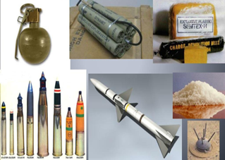
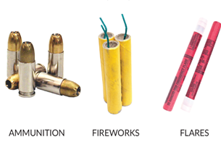
Regulated items under GEWCA – Explosives
 | Items | Description | Photo
1 | All kinds of explosives | An explosive material, also called an explosive, is a reactive substance that contains a great amount of potential energy that can produce an explosion if released suddenly, usually accompanied by the production of light, heat, sound, and pressure. Legislation: Regulated as Explosives under GEWCA. Requirement: • Supply, Import and export licence required. • Not allowed for sales to the general public. • Only licensed companies may import/use them for authorised purposes. • Online platforms must not list, sell, promote these items.
Restricted/Non-Sensitive

Slide 30
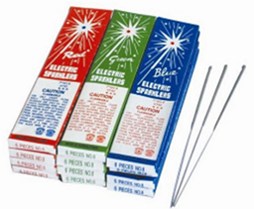

Regulated items under GEWCA – Explosives
 | Items | Description | Photo
2 | Wired Sparklers (3% or more Potassium Perchlorate) | Wired sparklers are thin metal-wire sticks coated with pyrotechnic composition. Wired sparklers with 3% or more potassium perchlorate composition are regulated Explosives. Legislation: Regulated as Explosives under GEWCA. Requirements: • Supply, Import and export licence required. • Not allowed for sales to the general public. • Only licensed companies may import/use them for authorised fireworks displays. • Online platforms must not list, sell, promote, these items.
Restricted/Non-Sensitive

Slide 31
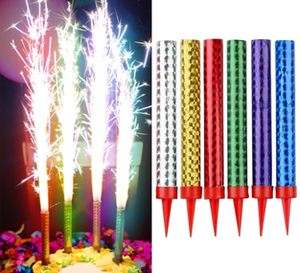
Regulated items under GEWCA – Explosives
 | Items | Description | Photo
3 | Tube Sparklers / Sparkler Candles (Tube-Type Sparklers) | Tube sparklers (also known as sparkler candles) are cylindrical tube devices which emit continuous sparks and are considered pyrotechnic articles. Legislation: Regulated as Explosives under GEWCA. Requirements: • Supply, Import and export licence required. • Not allowed for sales to the general public. • Only licensed companies may import/use them for authorised fireworks displays. • Online platforms must not list, sell, promote, or advertise these items.
Restricted/Non-Sensitive
Notes:
Tube Sparklers / Sparkler Candles

Slide 32
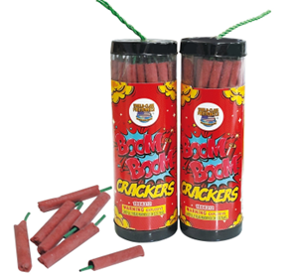
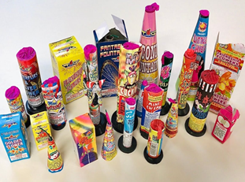
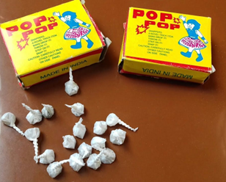
Regulated items under GEWCA – Explosives
 | Items | Description | Photo
4 | Other Fireworks (e.g., Firecrackers, Pop-Pop, Novelty Fireworks) | All types of fireworks and pyrotechnic devices used for entertainment or noise-making, including: • Firecrackers • Pop-Pop • Novelty Fireworks • Other Small Consumer Fireworks Legislation: Regulated as Explosives under GEWCA. Requirements: • Supply, Import and export licence required. • Not allowed for sales to the general public. • Restricted to licensed companies for approved event displays. • Online platforms must not list, sell, promote, or advertise these items.
Restricted/Non-Sensitive

Slide 33
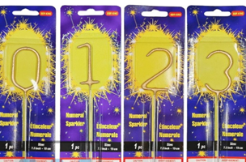
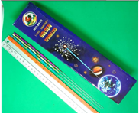
Items under Class License or exempted – Explosives
 | Items | Description | Photo
5 | Wired Sparklers (Lower-risk Explosives) | Wired sparklers are thin metal-wire sticks coated with pyrotechnic composition. These wired sparklers are classified as lower risk explosives if they meet all of these: Sticks or wires designed to be held by hand or free standing or fixed to a base. The total length, including the part, which is not coated with explosives composition, when unbend must not exceed 40cm. They could be bend into numbers or shaped designs eg. heart, star etc. If these wire sparklers contained potassium perchlorate composition, it must not more than 3% composition. Regulated as Lower Risk Explosives under GEWCA. Requirements: • Must comply with the Class Licensing Order (storage, handling, documentation). • Accurate declaration of chemical composition required during import. • Online platforms must verify compliance before allowing listings.
Restricted/Non-Sensitive

Slide 34
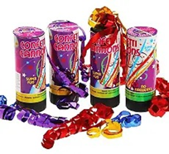
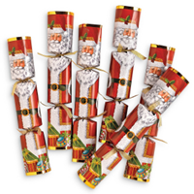
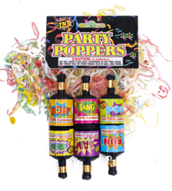
Items under Class License or exempted – Explosives
 | Items | Description | Photo
6 | Party Explosives: Party Poppers, Confetti Poppers, Christmas Crackers | A pyrotechnic device designed to project confetti or streamers and to emit a report when an igniting string is pulled and containing an explosive substance with a mass not exceeding 20 milligrams. Regulated as Lower Risk Explosives under GEWCA. They are exempted from licensing. Requirement: Exempted from Import / Export Licence. Use for intended purposes. Accurate declaration of chemical composition required during import. Online platforms must verify compliance before allowing listings.
Restricted/Non-Sensitive

Slide 35
GEWCA Regulatory Regime For EPs

Slide 36
Regulated Activities under GEWCA
Licence | Guns | Explosives | Explosive Precursors (EPs)* | Noxious Substances | Weapons
Manufacture | ü | ü | ü | ü | ü
Supply | ü | ü | ü | ü | ü
Possess | ü | ü | ü | ü | ü
Store | ü | ü | ü | - | -
Repair | ü | - | - | - | ü
Dispose | ü | ü | ü | ü | ü
Range | ü | - | - | - | -
Import/Export | ü | ü | ü | ü | ü
Conveyance | ü | ü | ü | ü | ü
Rock Blasting | - | ü | - | - | -
Fireworks Display | - | ü | - | - | -
Activity regulated under previous AEA and regulations
Activity is previously regulated but subsumed under a broad activity. GEWCA narrows the activity further to be licensed as a specific and separate activity
(-) Not applicable

Slide 37
List of 15 Explosive Precursors regulated by the Police
 | EP | Regulatory Threshold (if any)
1 | Ammonium nitrate | any mixture of components one of which is ammonium nitrate, but not including — aqueous solutions containing less than 60%, weight in weight, of ammonium nitrate; or any material in solid form comprising a mixture of components, one of which is ammonium nitrate, where the nitrogen content derived from ammonium nitrate is less than 28% by weight of the said mixture.
2 | Ammonium perchlorate | -
3 | Barium nitrate | excluding preparations and solutions containing less than 10%, weight in weight, of barium nitrate.
4 | Guanidine nitrate | -
5 | Hydrogen peroxide | excluding preparations and solutions containing not more than 20%, weight in weight, of hydrogen peroxide
6 | Potassium chlorate | -
7 | Potassium nitrate | excluding preparations and solutions containing less than 5%, weight in weight, of potassium nitrate or a combination of both potassium nitrate and sodium nitrate.
8 | Potassium nitrite | excluding aqueous solutions containing less than 5%, weight in weight, of potassium nitrite
9 | Potassium perchlorate | -
10 | Sodium chlorate | -
11 | Sodium nitrate | excluding preparations and solutions containing less than 5%, weight in weight, of sodium nitrate or a combination of both sodium nitrate and potassium nitrate.
12 | Sodium nitrite | excluding aqueous solutions containing less than 5%, weight in weight, of sodium nitrite
13 | Sodium perchlorate | -
14 | Perchloric acid | -
15 | Tetranitromethane | -

Slide 38
GEWCA Regulatory Regime For Weapons/ Noxious Substances

Slide 39
GEWCA Regulatory Regime for Weapons
Weapons are categorised into 3 different types with corresponding regulatory controls and the number of regulated bladed weapons are expanded from 6 to 24:
Weapons Category | Licence | Remarks
Type 1 | Individual licensing [Weapons designed to cause hurt and have very limited legitimate day-to-day uses ] | Items pose high risks to safety and security and dealers/owners require an individual licence. Licence required from PRD. Approval is not typically granted for personal collection etc (except for swords).
Type 2 | Class licensing [Weapons designed to cause hurt but have legitimate uses (e.g. blunt swords for sporting purpose)] | Items pose moderate risk and dealers/owners must abide by class licence. Automatically a Class Licensee if all conditions are complied. No application and no approval required from PRD.
Type 3 | Exemption [Weapons designed as tools of trade but may be misused to cause hurt (e.g. axes and parangs were designed for agricultural and woodworking purposes] | Items pose low risks and dealers/owners are exempted from licensing requirements. No approval required from PRD.

Slide 40
Summary of Weapons – Type 1 (Licence)
 | Weapon | GEWCA
S/N | Weapon | Individual Licence | Class Licence | Exemption
1 | Arbalest | ü
2 | Crossbow | ü
3 | Throwing knife | ü
4 | Butterfly/Gravity Knife | ü
5 | Flick knife / switchblade | ü
6 | Wasp knife | ü
7 | Throwing stars / Shuriken | ü
8 | Knuckledusters | ü
9 | Shoge | ü
10 | Nanchaku | ü
11 | Kasari-Fundo,Kusari-Fundo Manrikigusari | ü
12 | Karambit | ü
13 | Sai / Jitte | ü
14 | Blow pipe & dart | ü
15 | Bayonet | ü | If the blade is blunt, it will be regulated as Type 2 weapon under GEWCA as Class Licence.
16 | Sword | ü
17 | Spear | ü
18 | Dagger | ü
19 | Chinese whip/whip spear | ü

Slide 41
Summary of Weapons – Type 2 (Class Licence)
S/n | Weapon | GEWCA
S/N | Weapon | Individual Licence | Class Licence | Exemption
20 | Blunted Bayonet |  | ü
21 | Blunted Sword |  | ü
22 | Blunted Spear |  | ü
23 | Blunted Dagger (including dirks, kirpans and kris) |  | ü
24 | Blunted Chinese whip / whip spear |  | ü
25 | Bow & arrow (used for sporting purpose) |  | ü
“Blunted” weapon means the cutting edges and points are blunt AND not capable of causing serious injury or death. Individual licence (Type 1) is required if the blades are not blunted.

Slide 42
Summary of Weapons – Type 3 (Exempted, No Licence)
S/n | Weapon | GEWCA
S/N | Weapon | Individual Licence | Class Licence | Exemption
26 | Machete / Parang |  |  | ü
27 | Diving knife / Hunting knife |  |  | ü
28 | Scythe / sickle shaped article |  |  | ü
29 | Axe |  |  | ü

Slide 43
Comparison Table for Possession for Weapons
 | Type 1 Weapon (Bladed Weapon) | Type 2 Weapon (Blunt Weapon)
Blade | Sharp | Blunted
Weapons | Bayonet, Spear, Chinse Whip Spear, Sword, Dagger (including dirks, kirpans and kris) | Bayonet, Spear, Chinse Whip Spear, Sword, Dagger (including dirks, kirpans & kris)
Licensing Regime | Individual Licence | Class Licensing
Licensing requirements | Person Fit and Proper Assessment Approved address only (cannot remove without approval) Suitable Storage Security and Safety Plan Record Keeping Approval required before changes to approved plans, termination of licence | Fulfil the class licensing conditions No Licence, No Application or Approval from PRD
Possession Licence Fees | $150 regardless number of weapons for 5 years. | NA
Amendment Fees | $40 for each amendment (regardless requests) with no change to existing licence | NA
Licence/Amendment Application | Through GoBusiness Portal using Singpass. | NA
Disposal | Through disposal facility | Through disposal facility
Regulatory Action | Onsite Compliance Checks are conducted by Authority Enforceable | Enforceable
Penalties | Violations for unlicensed activities may result in imprisonment of up to 5 years and fines of up to $50,000 for individuals and up to $100,000 for companies.
Related activities | Other related transportation, import licences & fees are required (e.g. transport of weapon from point A to B) | -

Slide 44
General Class Licensing Conditions
Every class licensee must comply with all the following under the class licence:
(a) must ensure that the weapon, if blunted, remains blunted;
(b) must not abandon the weapon except by authorised disposal facility;
(c) must take reasonable precautions (e.g. key and lock) to ensure that the weapon —
(i) is not lost or stolen; and
(ii) is not accessible or transferred to anyone else who is not authorised by or under the Act to possess the weapon
(d) must take reasonable precautions not to cause public alarm while carrying out the regulated activity authorised by the class licence.

Slide 45
Individual Licensing Conditions for E-Commerce Platforms intending to sell Type 1 Weapons
1. The licensee may only supply the types of weapons as stated in the licence, unless otherwise approved by the Licensing Officer in writing. 2. The licensee shall only store weapons in a storage place approved by the Licensing Officer, including any temporary storage; e.g. pending delivery, while arranging for transportation of weapons, and for repair. 3. The licensee shall ensure that CCTV cameras and CCTV recording system(s) are installed and maintained at the storage premises. 4. The licensee is required to maintain weapon stock records showing: - Date of Import / Export - Import / Export Licence Number - Date of Sales of Weapons - Supplier/Buyer including company’s name and ACRA or individual’s name and identity card number - Quantity and Types of Weapons - Acknowledgement of Police advisory by Buyer/Customer 5. The licensee shall keep all stock and sales records for a period of not less than 3 years from the date the record is made.
Restricted/Non-Sensitive

Slide 46
Individual Licensing Conditions for E-Commerce Platforms intending to sell Type 1 Weapons (Con’t)
6. The licensee shall ensure that the weapon is carried in a fully concealed bag or casing whilst being transported and shall take reasonable efforts to ensure that the weapon does not cause any undue alarm to the general public. This is in addition to the weapons being fully sheathed, where applicable. 7. The licensee must ensure that the buyer is issued with a licence to possess type 1 weapon. 8. The licensee must verify the age of buyers to ensure that weapons are not sold to person below 18 years old. 9. Where any weapon needs to be disposed of, the licensee shall dispose of it in such a manner as prescribed by the Licensing Officer. 10. The licensee is required to obtain the Licensing Officer’s approval before employing any prospective employees to handle weapons, by submitting an “Application for Submission of Particulars of New Employee”. 11. Where any person ceases to be employed by the licensee, the licensee shall notify the Licensing Officer within 7 days of the cessation of employment by submitting an “Application for Deletion of Employee”. 12. The licensee shall notify the Licensing Officer of any change to the business address, at least 7 days before the change takes effect. 13. The licensee shall immediately notify the Police if there is any loss of weapons or security or safety related incident.

Slide 47
Class Licensing Conditions for E-Commerce Platforms intending to sell Type 2 Weapons (Platforms that have some control over the weapon)
The class licensee may supply the types of weapons that are covered by the class licence framework, i.e. Type 2 weapons. 2. The class licensee must take reasonable precautions to ensure that the weapon — a) is not lost or stolen; and b) is not accessible or transferred to anyone else who is not authorised 3. The class licensee must take reasonable precautions to protect other people from alarm relating to the licensee carrying out the regulated activity authorised by the class licence. 4. The class licensee must take all reasonably practicable steps to ensure that no Type 2 weapon is supplied by the class licensee to — an individual who is underage (below 18 years old); an individual who does not first produce evidence to the licensee purporting to show that that individual is not underaged; or a person who does not first produce to the class licensee acceptable proof of the person’s authorisation by or under the Act to possess the Type 2 weapon. 5. The class licensee is required to maintain stock books/records for at least 3 years, showing the following particulars: Date of Sales of Weapons Particulars of Buyer, including name, identity card number Quantity and Types of Weapons Acknowledgement of Police advisory by Buyer/Customer

Slide 48
Class Licensing Conditions for E-Commerce Platforms intending to sell Type 2 Weapons (Platforms that do not physically handle the weapon)
1. The class licensee must take all reasonably practicable steps to ensure that no Type 2 weapon is supplied by the class licensee to — an individual who is underage (below 18 years old); an individual who does not first produce evidence to the licensee purporting to show that that individual is not underaged; or a person who does not first produce to the class licensee acceptable proof of the person’s authorisation by or under the Act to possess the Type 2 weapon. 2. The class licensee is required to maintain stock books/records for at least 3 years, showing the following particulars: Date of Sales of Weapons Particulars of Buyer, including name, identity card number Quantity and Types of Weapons Acknowledgement of Police advisory by Buyer/Customer 3. The class licensee shall notify the sellers of their class licensing conditions.
Restricted/Non-Sensitive

Slide 49
Regulation 11(2) of GEWCA Order
Under Regulation 11(2) of the GEWCA Order, suppliers of Type 2 weapons are required to
Provide a copy of the “Advisory for Type 2 Weapon Owners” to every purchaser
The advisory sets out
Responsibilities of Type 2 weapon owners
Safe handling and storage expectations
The advisory is available on the SPF website

Slide 50
Case Studies and Penalties

Slide 51
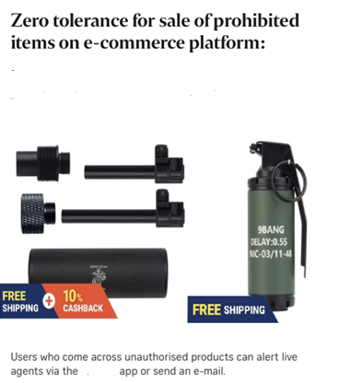
Case Studies
E-commerce Listings of Controlled Items Removed (ST report)
– E-commerce platforms removed listings for controlled items including parts of firearms after members of the public reported them. Two sellers were banned from the platform after such listings were discovered and reported.
- Offences involving prohibited/dangerous items
Restricted/Non-Sensitive

Slide 52

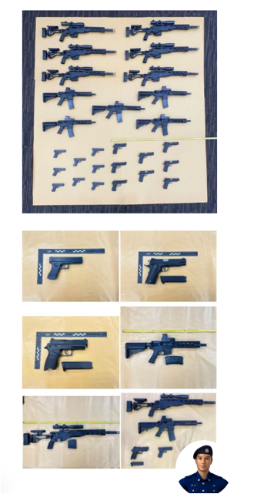
Case Studies
Replica Guns Seller Charged After Online Listing
– The Singapore Police charged a 44-year-old man for importing 154 replica guns after information was received about the sale of these items on an e-commerce platform. Police seized the items during a raid after tracing the online listings. ￼
Restricted/Non-Sensitive

Slide 53
Penalties under GEWCA
Maximum Fines
Unlicensed activities involving guns / explosives
– Up to S$50,000 (individuals)
– Up to S$100,000 (entities/companies) ￼
Offences involving prohibited/dangerous items
– Up to S$100,000 (individuals)
– Up to S$200,000 (entities/companies) ￼
Penalties may also include imprisonment and vary depending on offence and circumstances.
Restricted/Non-Sensitive

Slide 54
Non-regulated Items

Slide 55
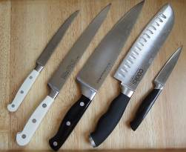
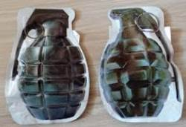
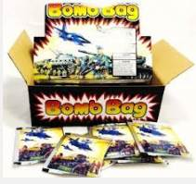
Non-regulated Items
 | Items | Description | Photo
1 | Domestic / Culinary / Kitchen Knife | These knives are cutting tools used in food preparation.
2 | Bomb Bags | A small sachet with an inner bag. When the inner bag is squeezed, the sachet is expended till the sachet pops. This takes place due to the reaction of baking soda with citric acid / vinegar resulting in forming of carbon dioxide gas. This expends the sachet till it pops.
Restricted/Non-Sensitive

Slide 56
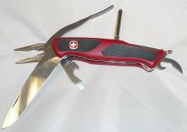
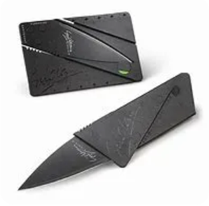
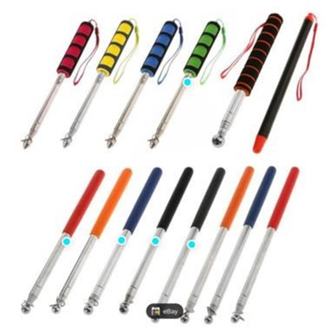
Non-regulated Items
 | Items | Description | Photo
3 | Foldable Knife / Swiss Army Knife | These are pocket knives or multi-tool generally have very sharp blade, as well as various tools, such as screwdrivers, a can opener, and many others. These attachments are stowed inside the handle of the knife through a pivot point mechanism.
4 | Tile Checker | A tile checker is a tool that is used for home improvement and renovation work
Restricted/Non-Sensitive
Notes:
.

Slide 57
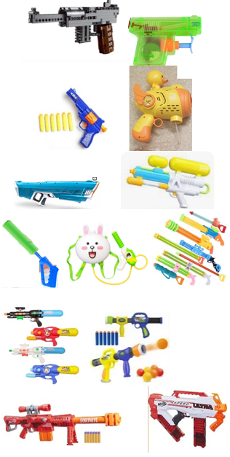
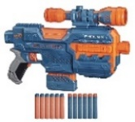
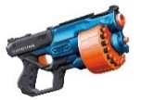
Non-regulated Items
 | Items | Description | Photo
5 | Children’s Toy Guns | Children’s toy guns are intended for play and recreational use. A children’s toy gun must meet all these criteria: i) It is a toy; ii) It does not resemble a real gun in make and appearance; iii) It cannot be easily modified to resemble a real gun; iv) It is in bright colours and has markings to distinguish it from real guns; v) It is unlikely to cause alarm, injury and/or hurt to others; and vi) It only shoots soft projectiles (if any) such as water, foam darts, soft rubber balls, etc which are designed to not cause harm and/or bodily injury.
Restricted/Non-Sensitive

Slide 58
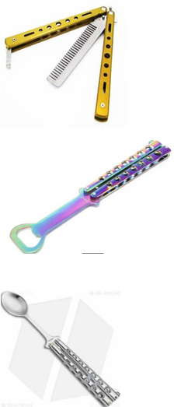
Non-regulated Items
 | Items | Description | Photo
6 | Butterfly trainer | A butterfly trainer is a tool for practicing and training flipping techniques safely. There is no blade end in the trainer. If there is blade in the trainer, it is a gravity knife/butterfly knife, which is a Type 1 weapon.
Restricted/Non-Sensitive

Slide 59
Key Takeaways
GEWCA requirements apply equally to online and offline activities
Posting or hosting listings for regulated or prohibited items may constitute an offence depending on the activities under the act
GEWCA provides for enhanced penalties, which may include fines and/or imprisonment for individuals/companies. Enforcement action could be taken against both sellers and platforms, where applicable.
Non-compliance detected may result in investigation and enforcement action. Business operations may be affected or disrupted during the course of investigation.
The transition / graced period has concluded – GEWCA is now fully in force
Platforms play a critical gatekeeping role and are expected to take reasonable and proactive steps to prevent misuse. Early compliance helps avoid operational impact, reputational risk and enforcement outcomes.

Slide 60
Resources

Slide 61
Relevant Websites
Overview of Gun Explosive Weapon Licences
https://www.police.gov.sg/e-Services/Police-Licences/Overview-of-Gun-Explosive-Weapon-Licences
Overview of Controlled Items, Prohibited Items and Non-regulated Weapons – SPF (PRD)
https://www.police.gov.sg/business-e-services/apply-for-gun-licence/information-on-controlled-items-prohibited-item-and-non-regulated-weapons
Information on Gun Licence Matters
https://www.police.gov.sg/e-Services/Police-Licences/Overview-of-Gun-Explosive-Weapon-Licences/Information-on-Gun-Licence-Matters
Information on Explosive Licence Matters
https://www.police.gov.sg/e-Services/Police-Licences/Overview-of-Gun-Explosive-Weapon-Licences/Information-on-Explosive-Licence-Matters

Slide 62
Relevant Website
Information on Explosive Precursor Licence Matters
https://www.police.gov.sg/e-Services/Police-Licences/Overview-of-Gun-Explosive-Weapon-Licences/Information-on-Explosive-Precursor-Licence-Matters
Information on Weapon and Noxious Substance Licence Matters
https://www.police.gov.sg/e-Services/Police-Licences/Overview-of-Gun-Explosive-Weapon-Licences/Information-on-Weapon-and-Noxious-Substance-Licence-Matters
Advisory for type 2 owners
https://www.police.gov.sg/-/media/Spf/e-Services/AE-Files/Advisory-For-Type-2-Weapon-Owner-on-Safe-Use-and-Storage-of-Weapons_1-July-2025.ashx
AGC Link for Law/reg
https://sso.agc.gov.sg/Act/GEWCA2021

Slide 63
FAQ

Slide 64
Thank you
Official (Open) / Non-Sensitive

